Slide 1
ESTILOS DE VIDA SALUDABLE
Presentado Por:
Yury Alejandra Serna Garzon
Javier Andres Duque Ocampo
Daniela Smith Florez Garavito
Presentado a:
Diana Escobar
Curso:
1001 JM
2019

Slide 2
WHAT IS HEALTHY FOOD?
Generalizing, it can be said that healthy eating is one that provides the nutrients that the body needs to maintain the proper functioning of the body, preserve or restore health, minimize the risk of disease, ensure reproduction, pregnancy, lactation, development and growth suitable.
To achieve this, daily consumption of fruits, vegetables, whole grains, legumes, milk, meat, poultry and fish and vegetable oil in adequate and varied quantities is necessary. If we do this, we are saying that we have a healthy diet.

Slide 3
Lessons
Daily, when consuming food there is no clear knowledge of its nutritional contents, calories, amounts of sodium or sugar
But how to know what each one contributes to the organism? For this we have in mind that the nutrients provided by food are classified into two groups: the macronutrients,
Which are part of fats, carbohydrates, and proteins; and the micronutrients made up of minerals and vitamins.

Slide 4
Habits to have a healthy life
Have a varied diet
Eat vegetables
Moderate the consumption of meat and fish
Include the egg
Just point of salt
Do not eat after hours
Consume vitamins and minerals in moderation
Organize your time
Have an exercise routine
Other activities
Improve your posture
Dedicate time to your hobbies
Exams for executives
Pamper your skin
Eye care
Foot care
Sleep well
Without excesses
Take rest times

Slide 5
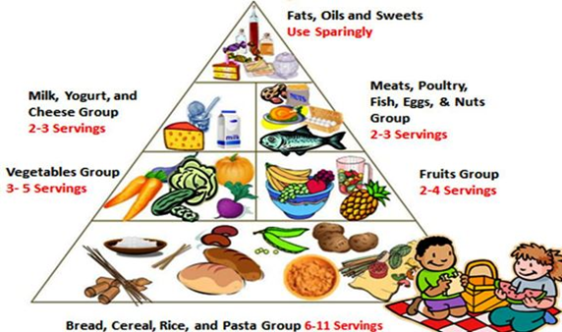
TYPES

Slide 6
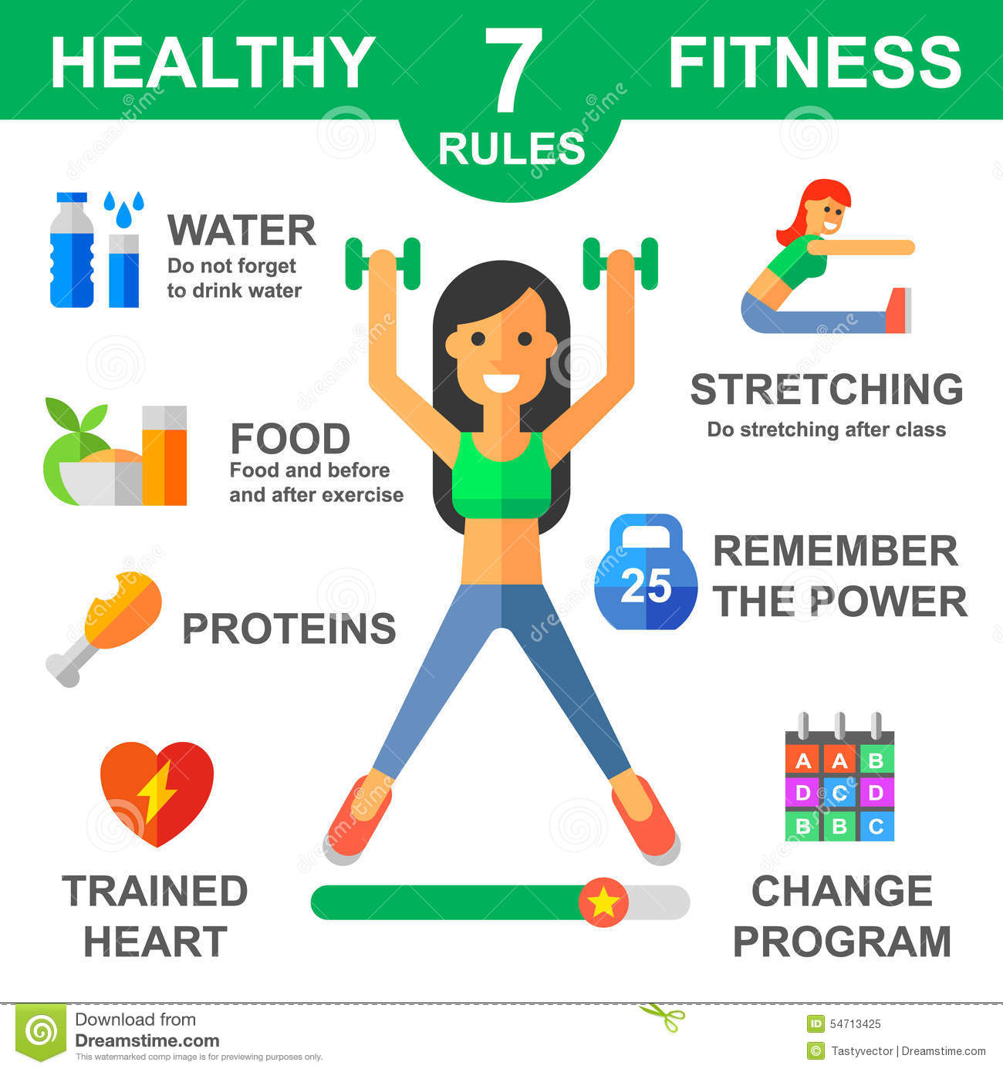

Slide 7


