Slide 1
the singing
Yury Alejandra Serna Garzón
Grado: 1001

Slide 2
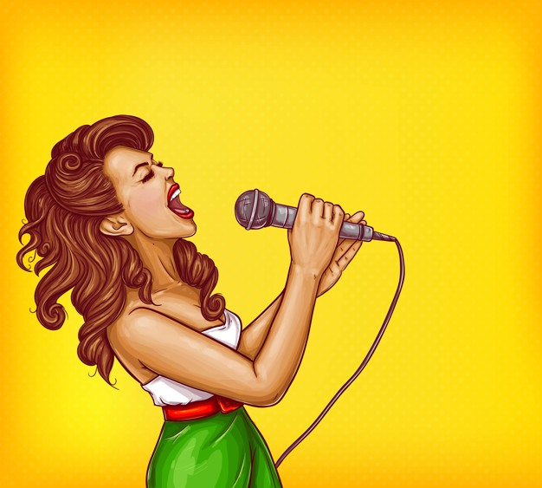
My opinion
I think it's singing singing because I get a way to express feelings and emotions

Slide 3
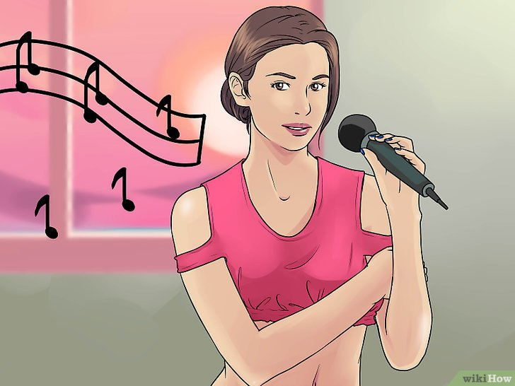

The singing
What is the singing?: The song is the controlled emission of sounds of the human vocal apparatus (voice), following a musical composition.

Slide 4
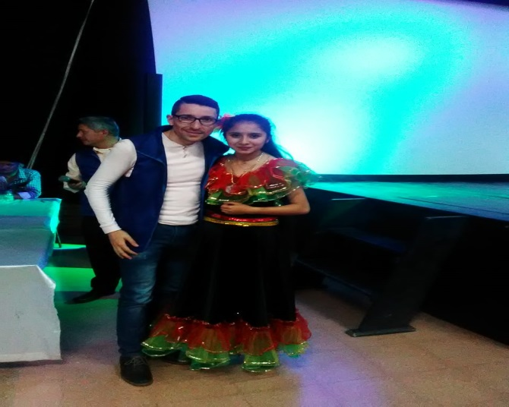
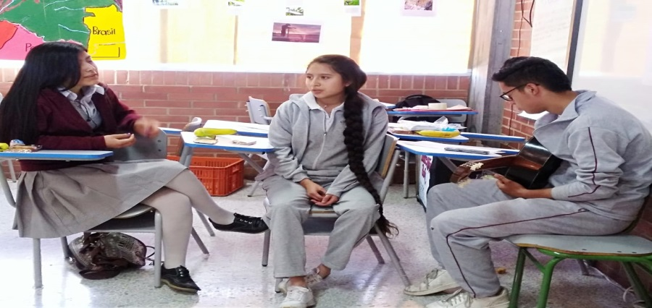
My like
I like to sing in my free time, I enjoy it, but what I like the most is being able to sing in encenarios

Slide 5

THANKS FOR YOUR ATTENTION

